Slide 1

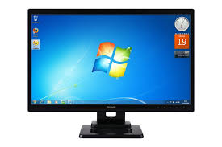
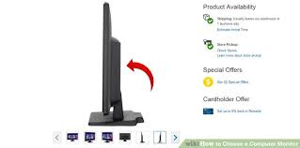

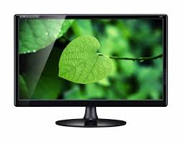
Authorized User
Image Processing
&
Decision making
Unlock Computer
A computer with
built in Camera
Unauthorized User
Lock Computer

